Slide 1
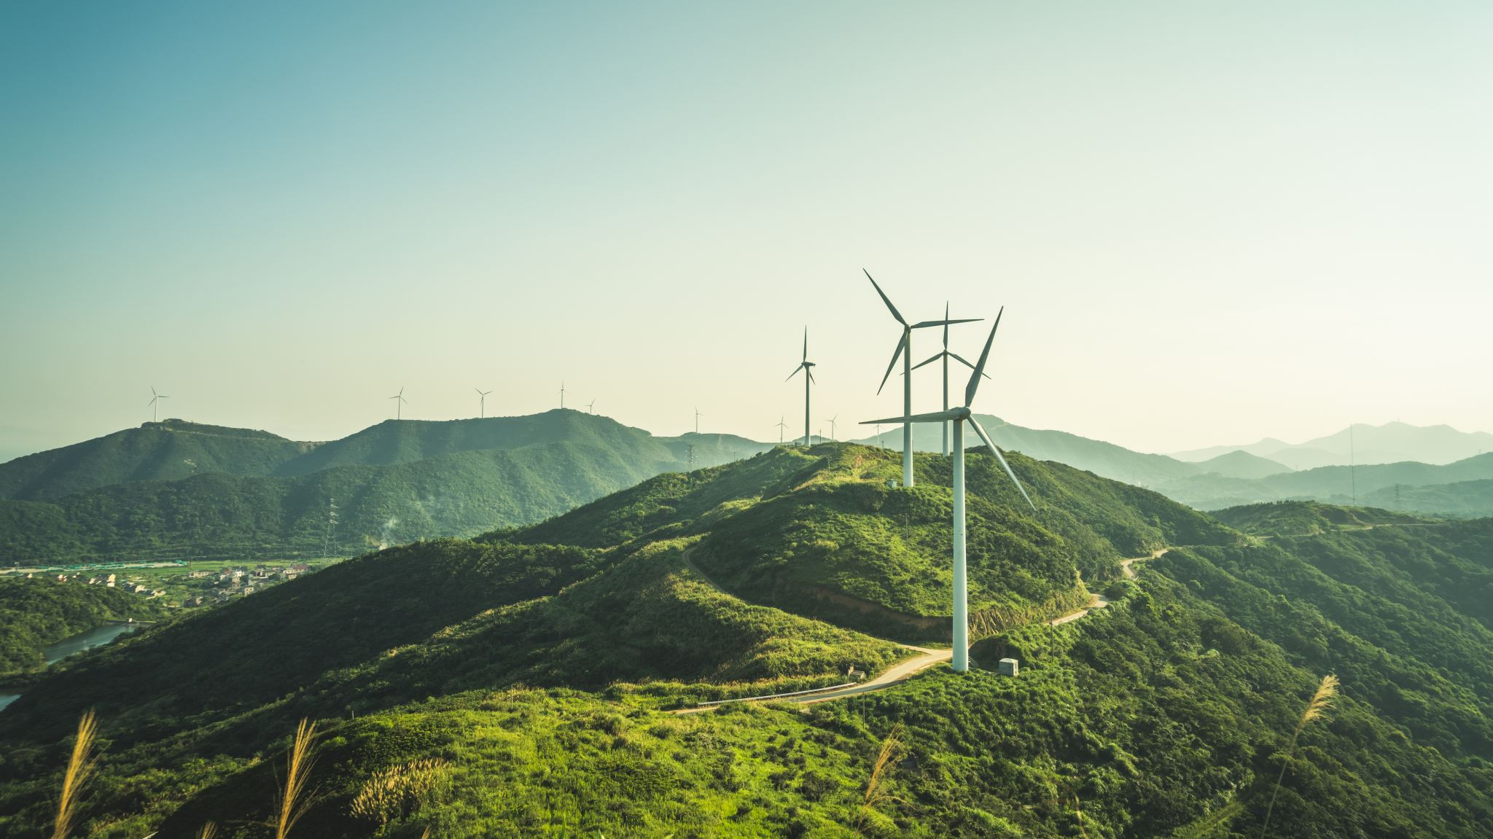
Lucky 7 – Optimal Systems
Names: Krutik Dhiren Patel
Course: COSC 412 – Software Engineering
Date: 5/9/2023

Slide 2
Team Members Analysis
Member Name | Project Role
Krutik Dhiren Patel | Team Manager and Content Developer
Logan Condron | Graphics Designer
Antonise Smith | Technical Writer and Document Formatter
Taylor Chaney | Tester

Slide 3
Product Overview
Our company, Optimal Systems have created a new e-commerce platform for Lucky 7 private convenience store.
The website allows users to create their personalized account to store details, including name, home address, phone number, credit card details, and account type.
Customers have option to shop from 3 unique categories, including promotional deals, food and drinks, and accessories.
The website also offers promotional deals for every registered customer, so they can receive products at the lowest price possible.

Slide 4
Product Overview – User Types
User Type | Functionality
Customer | Create account Update profile information, including name, home address, phone number, and credit card details. Explore and shop products from the existing inventory line-up. Track order status by using unique order ID. View customer reviews. View personalized promotional deals. View recent order history details, including a unique order ID, product name, price, and date of purchase.

Slide 5
Product Overview – User Types
User Type | Functionality
Business Owner | Add new inventory product. Delete existing inventory product using a unique product serial number. Update existing product details, including price and quantity. View transaction logs. Hire drivers.
Driver | View delivery list/schedule. View customer data, including name, delivery address, and phone number. Update delivery status for each order ID associated with each driver.

Slide 6
Product Goals
Customer Perspective: Our goal behind the implementation of the new Lucky 7 e-commerce platform is to provide customers with quality products and delivery services, so it will help save transportation time, and increase productivity rate.
Business Perspective: Our goal behind the integration of the new Lucky 7 e-commerce platform is to increase the business sales by attracting more customers to shop products through online website.

Slide 7
Project Status – Present Scope – Customers
Feature | Purpose
Login/Registration | If users do not have an existing account, then users will have the opportunity to register a new account by using their existing Gmail or Yahoo email addresses. In the registration form, users can enter vital data elements, including name, delivery address, phone number, credit/debit card details, and their account type. If a user already has an existing Lucky 7 account, then they can directly utilize the login form to validate their identification.

Slide 8
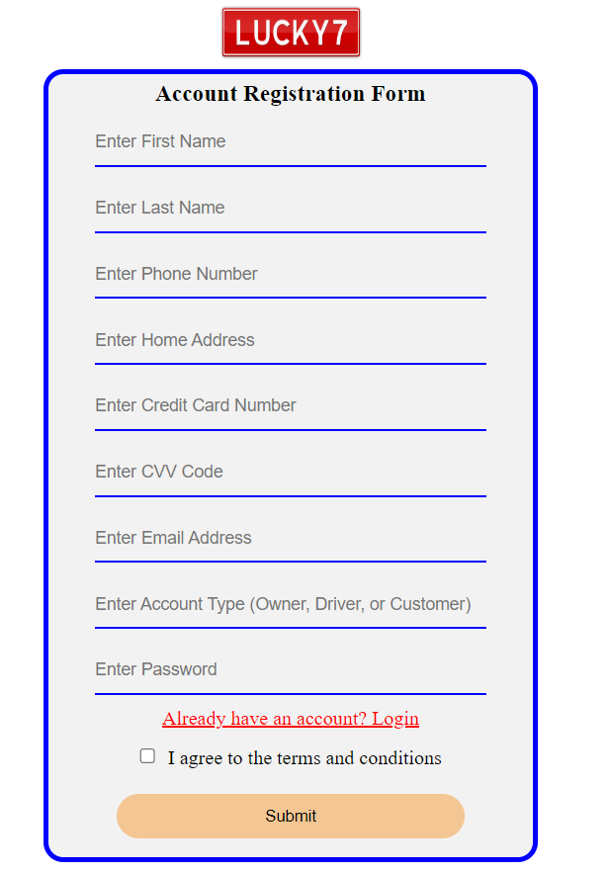
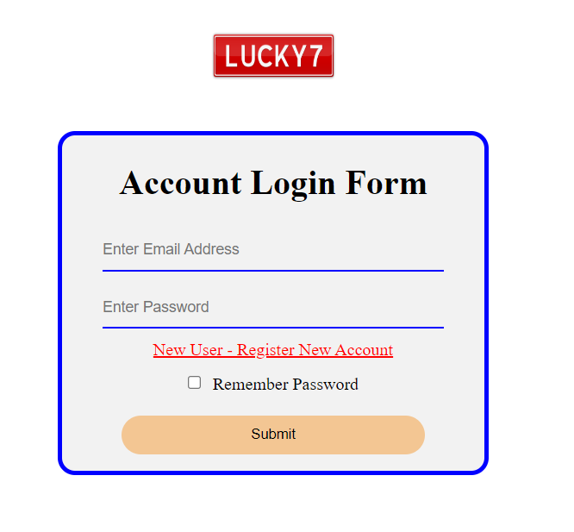
Project Status – Present Scope - Customers

Slide 9
Project Status – Present Scope – Customers
Feature | Purpose
Inventory Exploration Shopping Order history Track order | Users can navigate to three different inventory pages, including food and soft drinks, accessories, and promotional deals. Each inventory item will include its product label, a unique serial number, name, price, and quantity. Users can enter the desired quantity and click on the add to cart button to send that item to their shopping cart. Once the user clicks the checkout button, an order review page will be displayed before performing final checkout procedures. Each order will be assigned a unique order ID, which can be used later to track the progress of your order. The order history page will also get updated automatically each time the user perform final checkout.

Slide 10
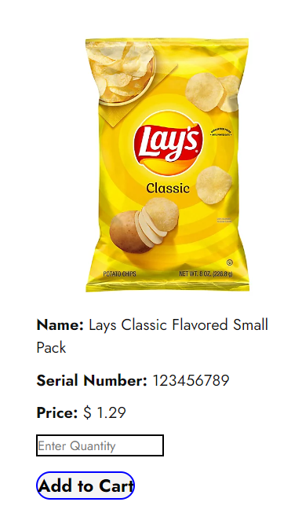
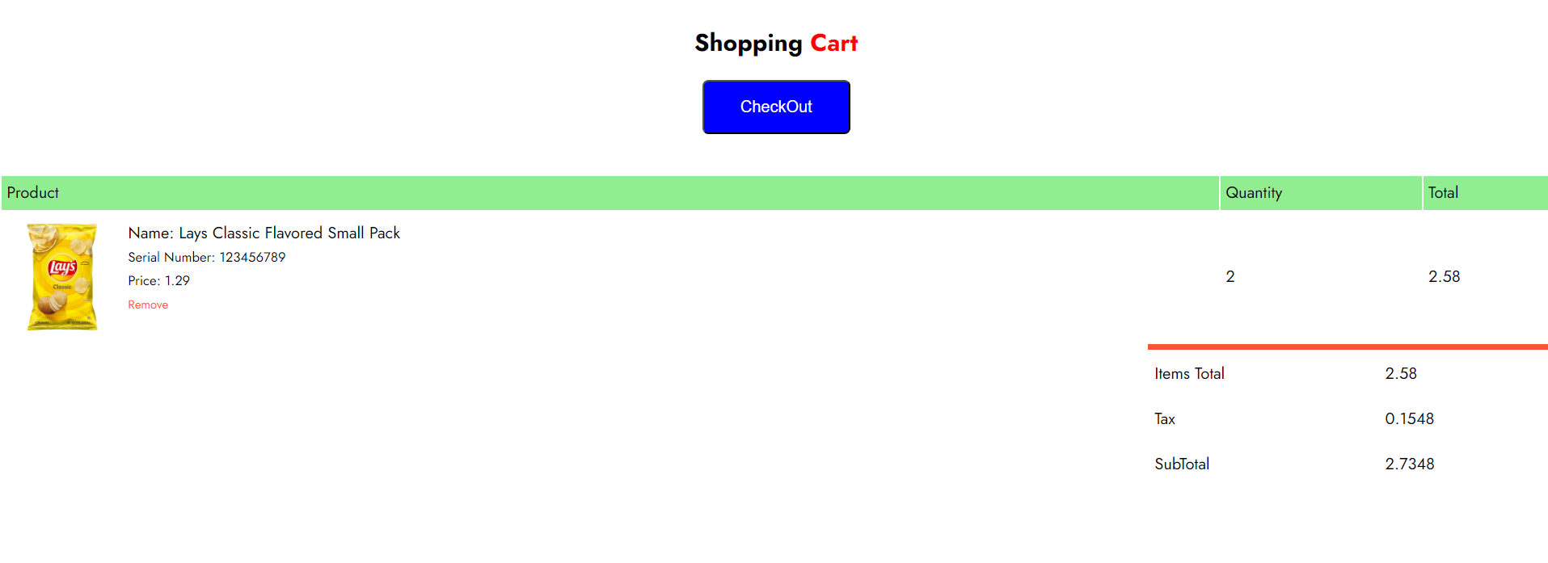
Project Status – Present Scope - Customers

Slide 11
Project Status – Present Scope – Owner
Feature | Purpose
Add inventory product Delete inventory product Update inventory product View transaction logs | The business owner has the functionality to perform inventory alterations, including to add a new item, delete existing inventory item if it goes out of stock, and update existing inventory product, in terms of its price and quantity. The owner will be able to monitor the sales of the online platform through transaction logs, which includes all the payment and checkout logs performed by every user.

Slide 12
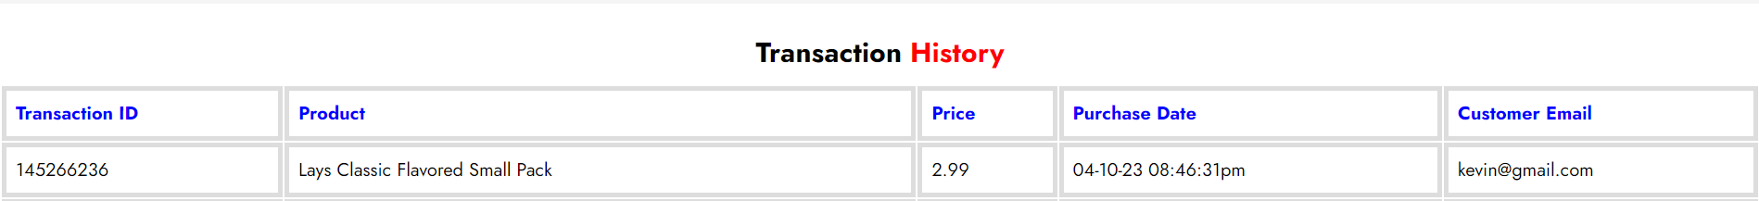
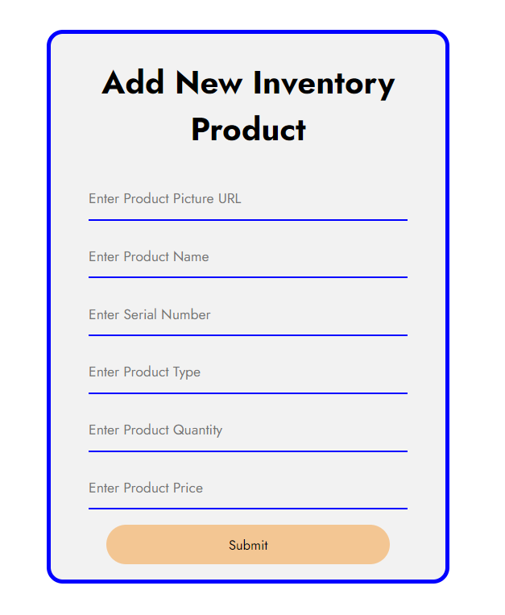
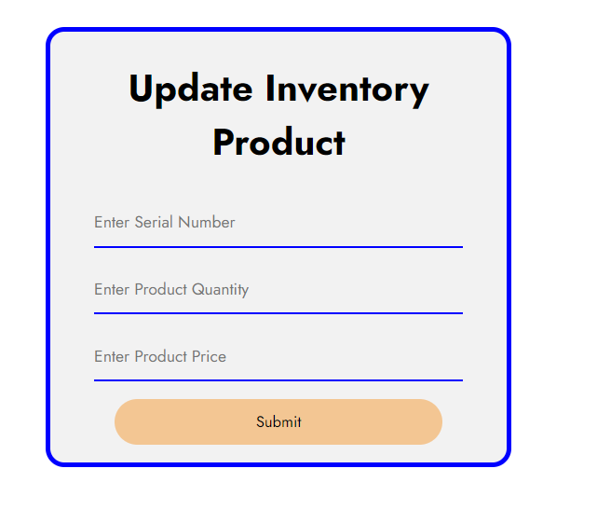
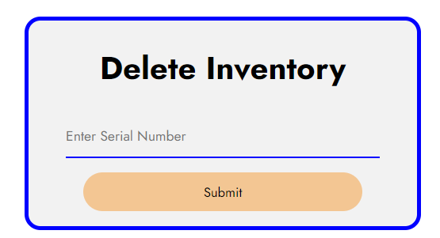
Project Status – Present Scope – Owner

Slide 13
Project Status – Present Scope – Driver
Feature | Purpose
View delivery schedule/list. Update new delivery status (Order placed, Order picked-up, Order in-transit, and Order delivered). View required customer data, including customer name, delivery address, and phone number. | As the users perform order checkouts, each order will randomly be assigned to each driver using their email address. The drivers can use the delivery schedule to view all the deliveries they have to perform. The drivers have a functionality to update delivery status of each order using the unique order ID. In the schedule list, customer’s name, delivery address, and phone number will be visible. Once the order is delivered to the customer, then that section of the schedule will be highlighted in green.

Slide 14
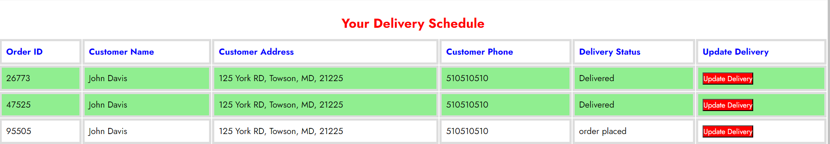
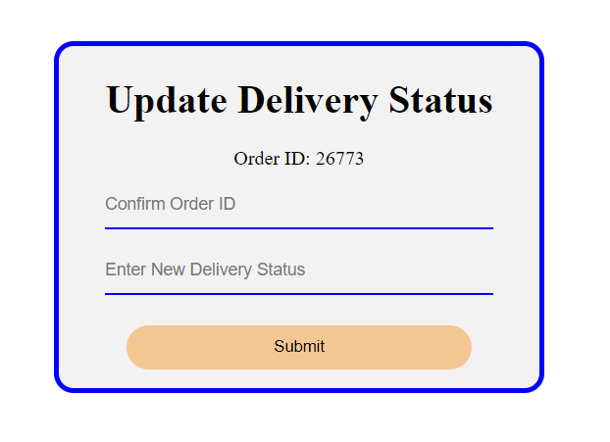
Project Status – Present Scope – Driver

Slide 15
Project Status – Future Scope
For customers, we will add order return functionality, so if the customer no longer needs the ordered product, they can use the website to activate an order return request.
We will add refund policies and functions, so if a customer return any product, then they should have the ability to request a refund directly through the website.
For the business owner, we will add real-time notification system, so if a product goes out of stock, then the owner will be altered to ensure that they perform the necessary actions.
We will implement an inbox message system, which will allow to store all the notifications regarding order tracking, new promotional deals, inventory, or any account alerts.
Lastly, we will add a new microphone feature in the existing search bar, so instead of typing, users can use the microphone to use their voice to search for products.

Slide 16
Project Retrospectives
During the project, there some elements that went well, including the organization of the project in terms of source code because every member distributed the work equally, and we performed regular code reviews.
By doing code reviews, it helped to comprehend and make vital modifications to the code that were done by other members.
All the features that were planned are integrated in our website, and there are no missing features.
In addition, when we were analyzing how MySQL would react if hundreds of records are stored in the database, then based on our test, the medium was able to hold all the data, and when we performed insert, delete, and update statements, then all operates performed without any SQL exception errors.
Our decision of choosing HTML for our website deployment is proven to be right because every user from various technical devices can utilize our website without any compatibility factors.
Performing website demos with random users was an effective approach because when external users utilized the website, then they were able to point out some issues regarding both usability and features that our group was unfamiliar with. Thus, by using the user feedback our team was able to improve the overall quality and security of the software.

Slide 17
Project Retrospectives
We learned that when creating user stories, we should only implement the stories that our group is able to perform in the time given because having many features can lead to mis-functionalities if not tested effectively.
Performing code reviews and pair programming is crucial because it is evident that not every member knows how to code a certain segment. So, by coding together, it helped to gain new insights and increased the overall productivity rate.
Whenever we build a software, it is always important to test our code both during and after the development stage because since our group performed multiple tests for every code, it helped reduced the overall complexity of the project because fixing smaller code segment is easier than a huge code block.
Lastly, we also learned that if we are not able to detect any code errors, then it does not mean that there are no errors because when we provided website demos, many users pointed a few errors that we were unable to navigate.

Slide 18
Project Retrospectives
We would like to change the inventory page, so when users would click on the product picture, a description layout should become visible. The new description layout will include a detailed description about the product, price, rating, and customer reviews.
We would like to change the working progress because we would like to begin designing our code in early stages. Doing this will help to ensure that all the user stories are completed in each sprint because some user stories require more time than anticipated.
We would like to write source code documentation because it will assist on how to operate and use a particular function in the code and will help other members to understand the code structure.
We would like to change the activation of the text-to-speech command because for now, once the text is highlighted the computer starts reading the text. But we would like to display an option to read aloud, and then read the text aloud only if the user activates the speech option.

